Slide 1







How Visualizing Ecosystem Land Management Assessments (VELMA) modeling quantifies co-benefits and tradeoffs in Community Forest management
Bob McKane¹, Jonathan Halama¹, Paul Pettus¹, Brad Barnhart¹,
Allen Brookes¹, Kevin Djang², Greg Blair³, Justin Hall⁴,
Joe Kane⁵, Paula Swedeen⁶, Laurie Benson⁷
¹ U.S. Environmental Protection Agency; ² CSRA; ³ ICF International; ⁴ Nisqually River Council;
⁵ Nisqually Land Trust; ⁶ Washington Environmental Council;
⁷ Washington Department of Natural Resources
2018 Northwest Community Forest Forum
Astoria, Oregon

Slide 2
Outline
What is VELMA? Where and how is it being used?
How can VELMA help community forest managers quantify co-benefits and tradeoffs?
Example application: Nisqually Community Forest
Scaling up from watersheds to regional basins

Slide 3
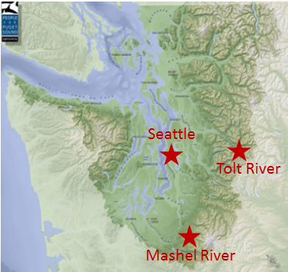
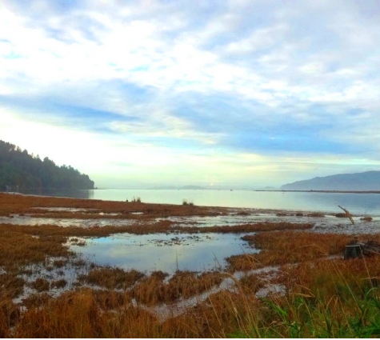
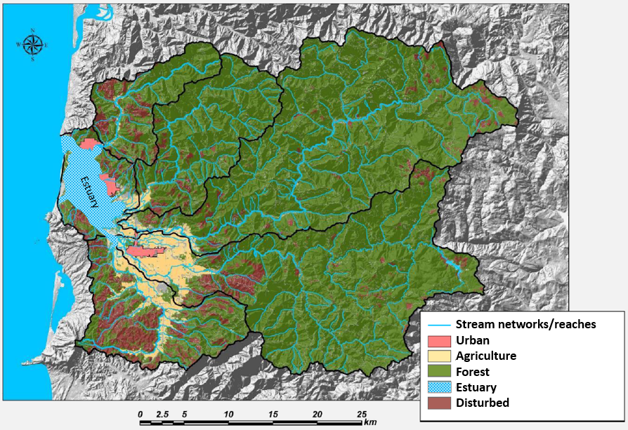
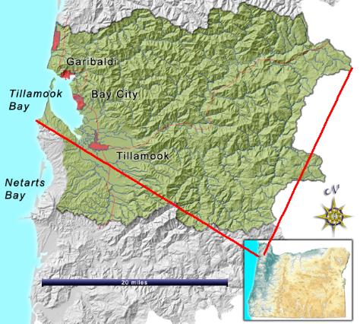
VELMA PNW Applications
Purpose: Demonstrate and transfer VELMA and associated tools to Communities, Tribes, States of WA and OR to use in formulating watershed restoration plans
Applications:
Puget Sound Subwatersheds: Salmon recovery, drinking water, flood protection, carbon sequestration, community-based forestry…
Puget Sound Basin (12,138 mi²): Whole-basin framework linking terrestrial, estuarine and ocean models informing Puget Sound recovery planning
Tillamook Bay Estuary & Watersheds (560 mi²): Restore upland, floodplain, estuarine eco services
3
USEPA Office of Research and Development
National Health and Environmental Effects Research Laboratory

Slide 4
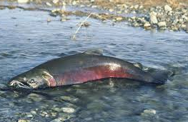
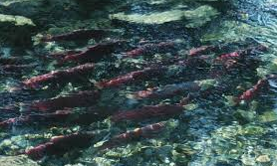
Nisqually Community Forest (NCF)
How best to get from
this back to this ?
Tools for whole-watershed restoration planning
Ecohydrology (VELMA)
Stream shade & temperature (Penumbra)
Fish habitat (EDT)
Tool transfer to Community Forest stakeholders
USEPA Office of Research and Development
National Health and Environmental Effects Research Laboratory
4
Notes:
ANIMATED SLIDE
An important premise of this collaboration is that well-managed working forests can simultaneously promote salmon recovery, forest sector jobs and other community goals.
In this talk I’ll briefly describe several tools that our group is linking together to help land managers identify whole-watershed management practices that best balance multiple objectives.
These tools include:
the VELMA ecohydrology model,
The Penumbra stream temperature model,
and EDT fish habitat model.
I’ll also describe how our modeling group has begun transferring these tools to the NCF community.

Slide 5
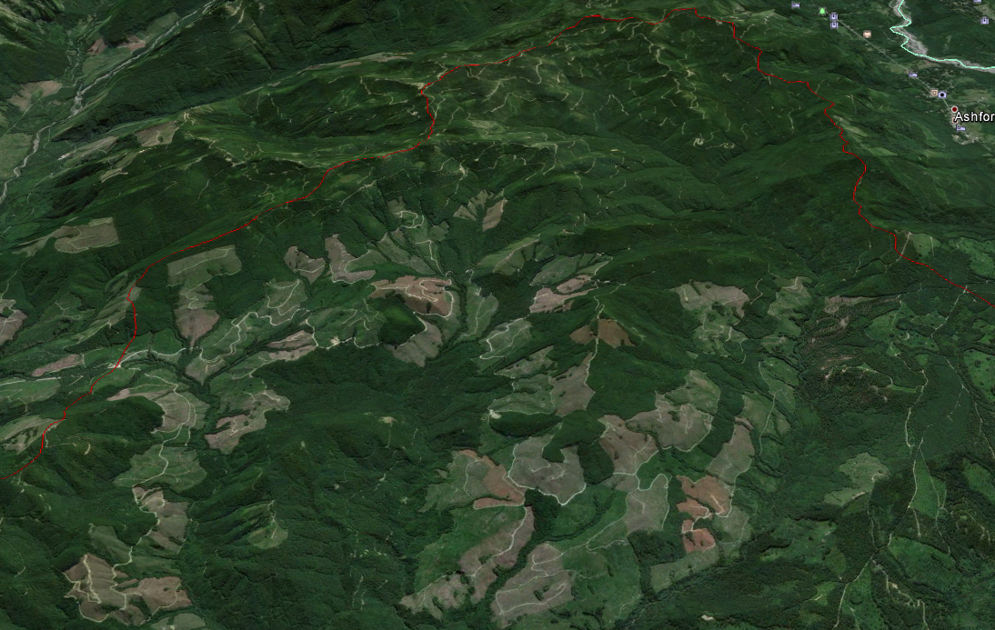
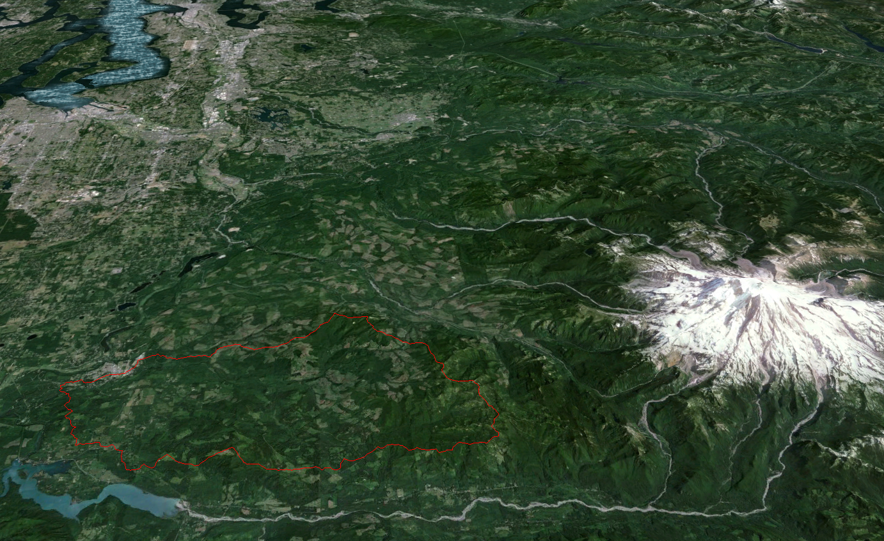
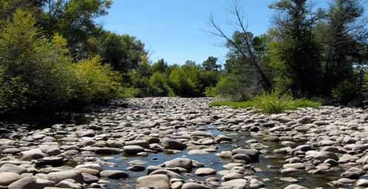
Mashel River Watershed… a key part of the Nisqually Community Forest vision
Puget Sound
Tacoma
Basin area: 209 km²
Observed streamflow:
Avg 210 cfs
max 5,600 cfs
min 3.8 cfs
6 cfs, 8/20/2015
USGS
gauge
Mashel Watershed
Principal salmon-producing
tributary in Nisqually Basin
Mt. Rainier
Nisqually River
USEPA Office of Research and Development
National Health and Environmental Effects Research Laboratory
Google Earth
5
Notes:
ANIMATED SLIDE
The Mashel River Watershed, just west of Mt. Rainier in WA state, is typical of intensively managed forest lands in the western Cascade Range.
Short harvest intervals, typically 40 – 50 years → conversion from old to young forest landscape during past century.
The Washington Department of Natural Resources and Nisqually Community Forest requested technical assistance from our EPA modeling group to explore effects of various forest management options on salmon habitat, forest productivity and yield, carbon sequestration and other objectives.
For this project a key question is, “Can long-rotation forestry improve summer low flow conditions that limit salmon migration & spawning in the Nisqually Basin?”
The 209 km2 (83 square mile) Mashel River Watershed is the principal salmon producing tributary to the Nisqually River.
It is generally recognized that late summer low flows (<4 cubic feet/second) in recent years are hindering salmon from reaching historical spawning habitat higher up in the Mashel.
CLICK (next slide)… Whereas 40 years ago the Mashel was known as one of the premier steelhead and chinook salmon rivers in the Pacific Northwest, fish populations have since plummeted for a number of reasons that may include declines in dry-season streamflow. The native run of Chinook salmon is now extinct, and the steelhead population is threatened.
The recent decline in salmonid populations has had a major impact on the Nisqually Tribe, whose cultural traditions have long depended upon sustainable harvesting of salmon from Nisqually Basin streams.
This view highlights how large portions of the Mashel sub-basin has been converted to young, intensively managed forests, a process that began over100 years ago and intensified during the past 40 years. This scene is fairly typical of PNW west-side forests.

Slide 6
Mashel Watershed Land Owners | Objectives
Forest Industry | Forest products, profit, conservation easements
WA DNR: Elbe State Forest | Forest products, clean water, salmon, recreation
Nisqually Land Trust and Community Forest | Salmon, cultural traditions, sustainable forest-sector jobs, recreation, tourism, carbon sequestration
Town of Eatonville | Clean drinking water, flood control, recreation
USEPA Office of Research and Development
National Health and Environmental Effects Research Laboratory
6

Slide 7
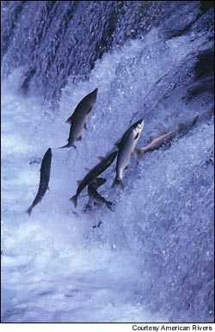
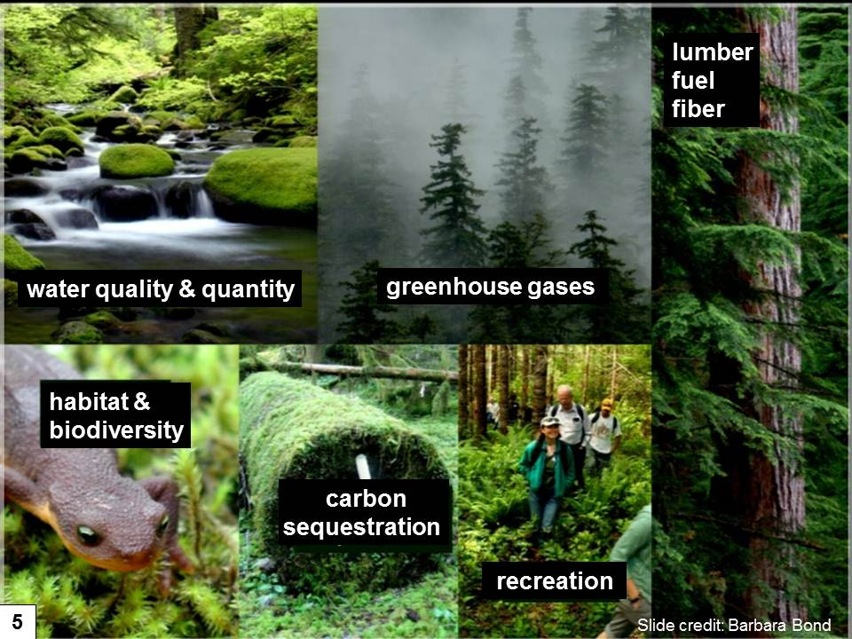
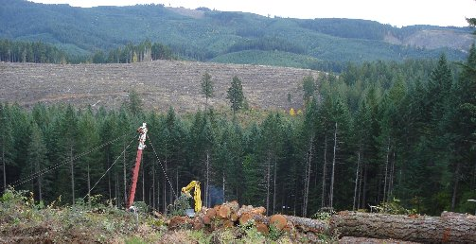
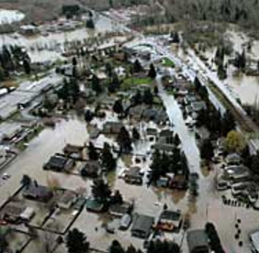
Can models help identify strategies for balancing tradeoffs among diverse objectives?
Tradeoffs?
forest products
fish & wildlife
clean water
knowledge.allianz.com
carbon sequestration
http://johnsonmatel.com/2008octdec_files/October/Portland_Oct17/hills.jpg
Tradeoffs?
flood prevention
7

Slide 8
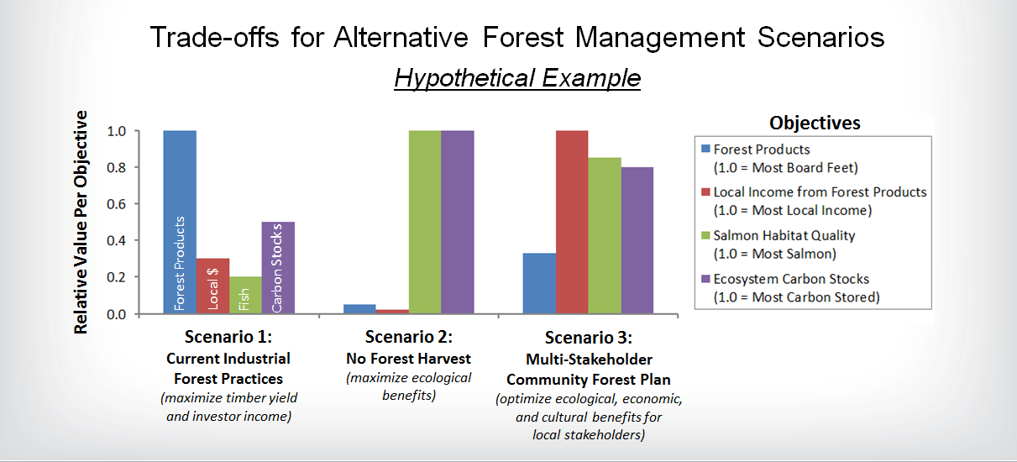
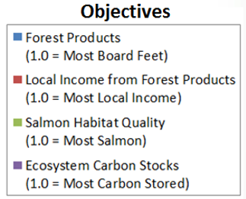
Tradeoffs for Alternative Forest Management Scenarios
Old Forest Landscape
(ecological reference condition)
8
8

Slide 9
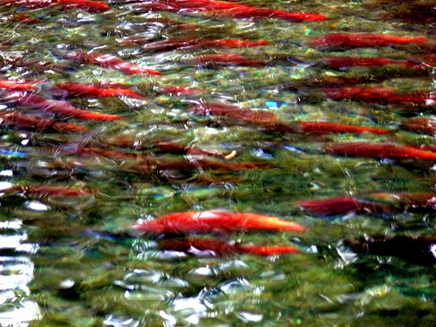
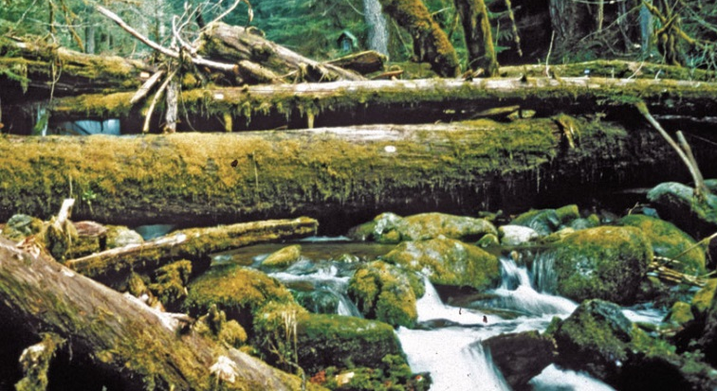
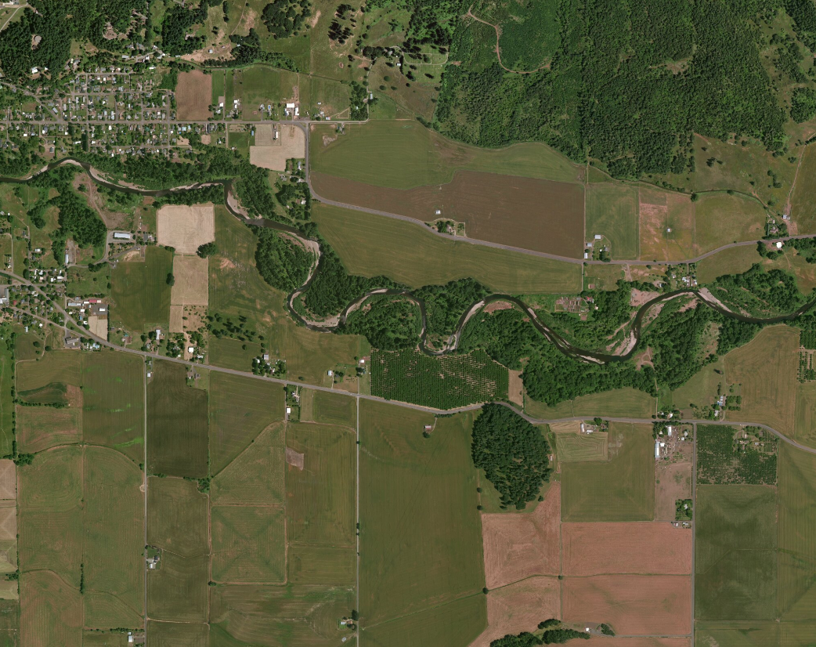
Linking Models for Salmon Recovery Planning
VELMA: Peak & Low Flow*
EDT: Fish Habitat
VELMA: Large Woody Debris
Penumbra: Stream Temperature
*Sediment model in development
9
Notes:
Our project is currently working on linking several models together to simulate the effects of forest management and climate change on salmon populations within the Mashel River watershed and Nisqually Basin.
The models include:
VELMA ecohydrological model for simulating streamflow and large woody debris
Penumbra shade/irradiance model for simulating effects of riparian forest biomass on stream temperature
and EDT fish population model for simulating effects of streamflow, LWD and stream temperature on salmon habitat, movement and mortality.
Next slide…

Slide 10
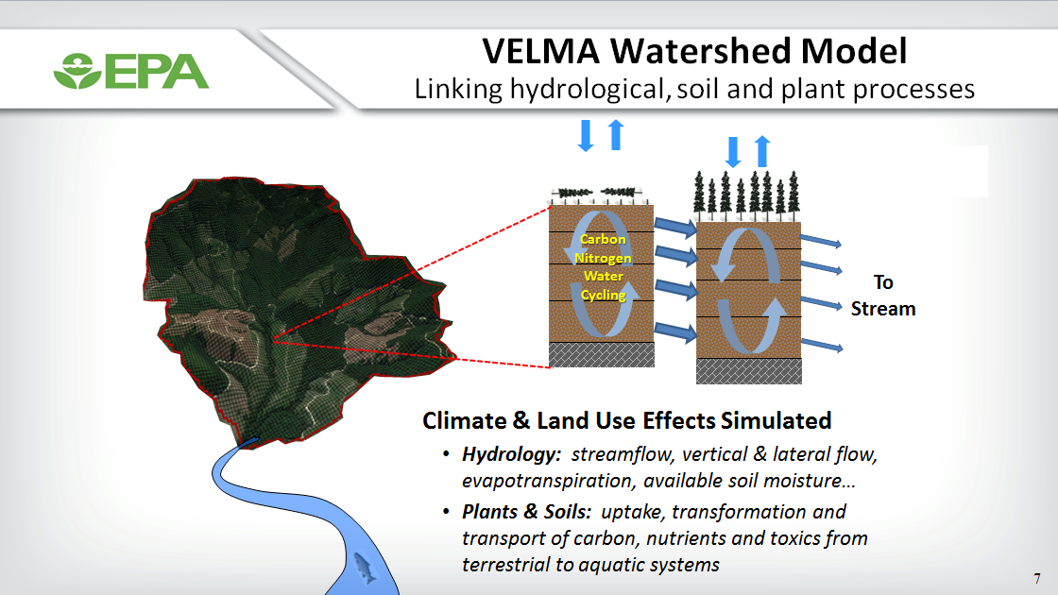

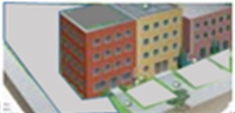
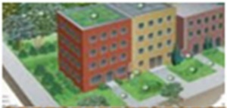
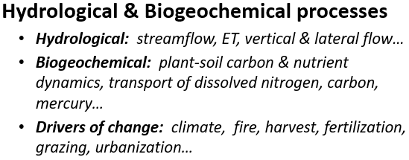
VELMA Ecohydrological Model
Integrated decision support for whole watershed restoration
Urban forests, green roofs, etc.
Ecosystem Services Simulated
Clean water & air
Flood protection
Food & fiber production
Carbon sequestration / climate regulation
Fish & wildlife habitat → population models
Ecosystem services→ human well-being
USEPA Office of Research and Development
National Health and Environmental Effects Research Laboratory
10
Notes:
To address these and similar questions, we developed VELMA (Visualizing Land Management Assessments), an eco-hydrological model that dynamically simulates the interaction of hydrological and biogeochemical processes across multiple scales.
Details of the model are described on EPA’s VELMA website:
https://www.epa.gov/water-research/visualizing-ecosystem-land-management-assessments-velma-model-20
…and two papers in Water Resources Research: http://onlinelibrary.wiley.com/doi/10.1029/2010WR010165/full and http://onlinelibrary.wiley.com/doi/10.1029/2012WR012994/full
Briefly, VELMA is a spatially-distributed model, with each pixel within a watershed representing a soil column and vegetation with specified characteristics.
Pixels are typically 30m, but smaller or larger grids can be specified as well.
VELMA simulates the effects of climate and land use on streamflow, evapotranspiration (ET), vertical and lateral flow, plant and soil C and N dynamics, and transport of dissolved nutrients and toxics.
Readily available data are used to apply the model using a daily time step. Simulations may extend for centuries as necessary.
VELMA simulates a number of ecosystem services…
We recently built the data of Moore et al. (2004) into VELMA, specifically to examine the how forest age influences streamflow.

Slide 11
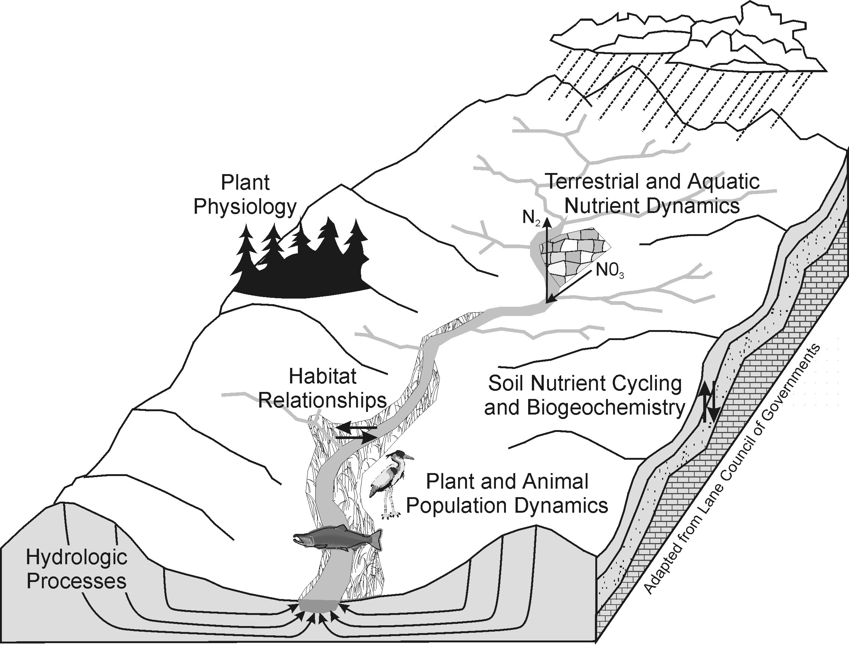
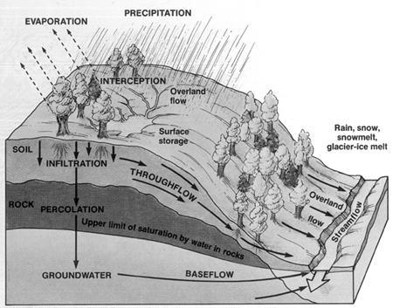
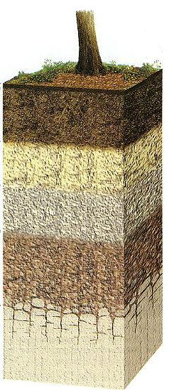
VELMA simulates how hydrological, soil and vegetation processes interact across spatial and temporal scales….
plots to watersheds, days to centuries
Nitrogen uptake
Litterfall
SOM formation
Decomposition
Nitrification
Denitrification
Etc.
Etc.
Land Use and
Land Cover
Watershed-scale processes
snobear.colorado.edu/IntroHydro/hydro.gif
Hillslope-scale processes
www.geo.lsa.umich.edu/.../SoilProfile100.JPG
Plot-scale processes
11

Slide 12
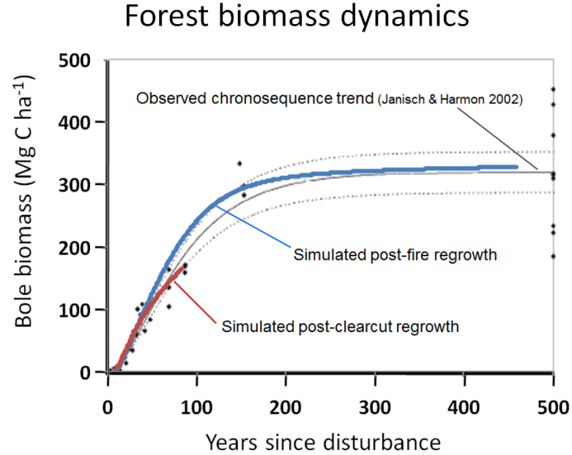
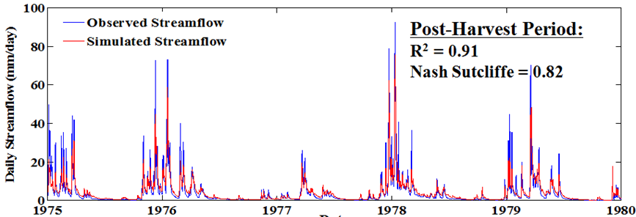
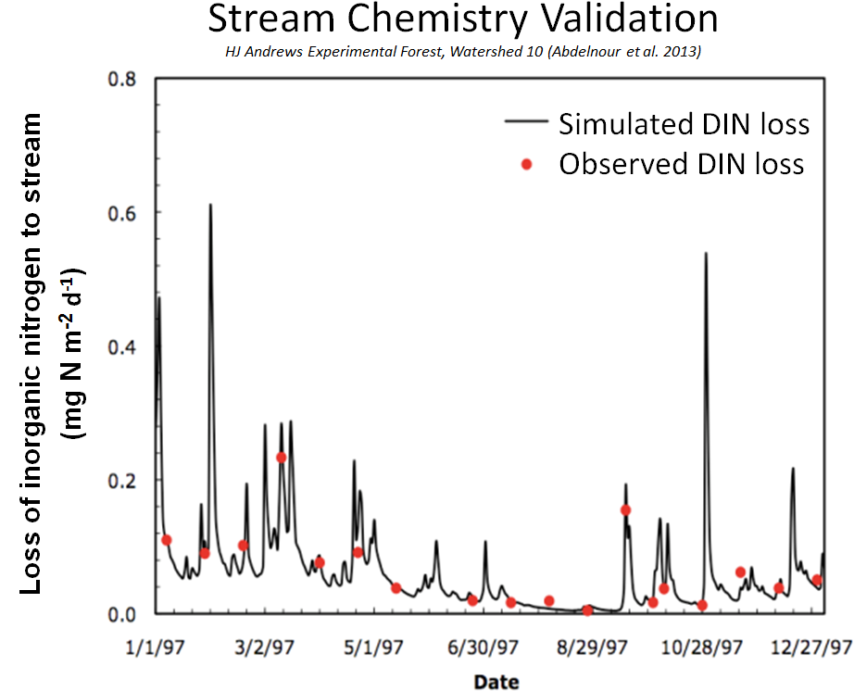
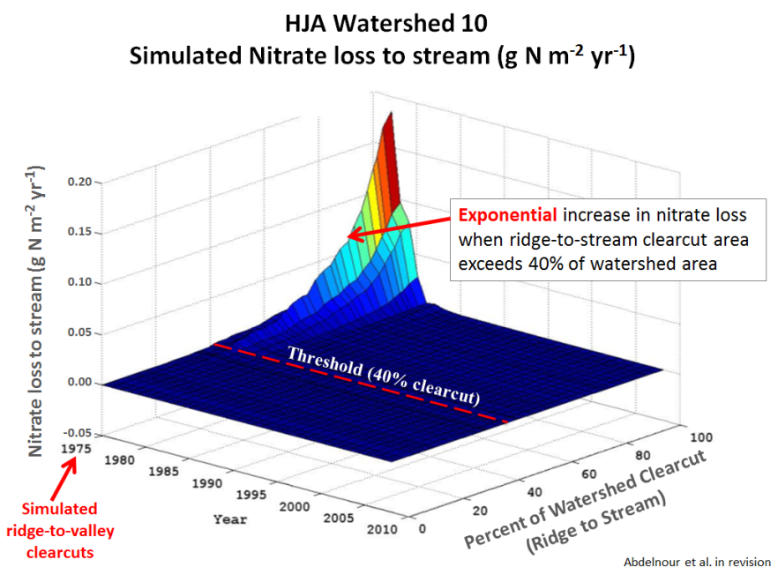
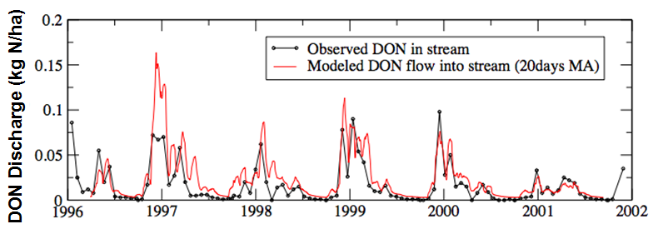
VELMA Validation Examples
HJ Andrews Experimental Forest, Watershed 10 (Abdelnour et al. 2011 and 2013, in Water Resources Research)
Streamflow
Forest Growth
Stream Chemistry
Stream Chemistry Response
to Harvest and Riparian Buffers
Simulated
clearcuts
12
Notes:
We have extensively tested VELMA for PNW west-side forests using observed data from many decades of experimental studies on the adjacent HJ Andrews Experimental Forest.
There is not time to go into details, except to say that VELMA produces results that are in very good agreement with observed data describing the effects of climate and forest harvest on stream flow, stream chemistry, and carbon and nitrogen dynamics in vegetation and soils.
These validation results have been published or are in preparation.

Slide 13
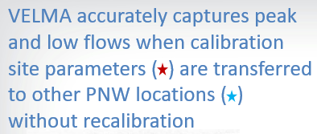
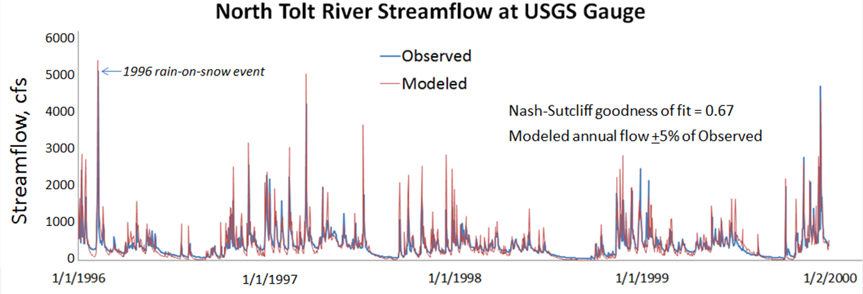
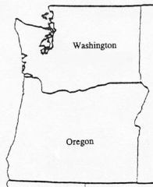
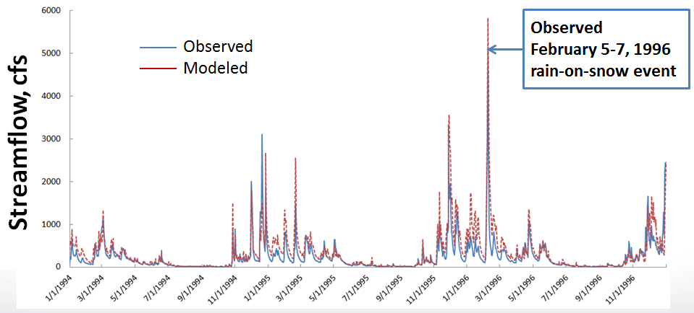
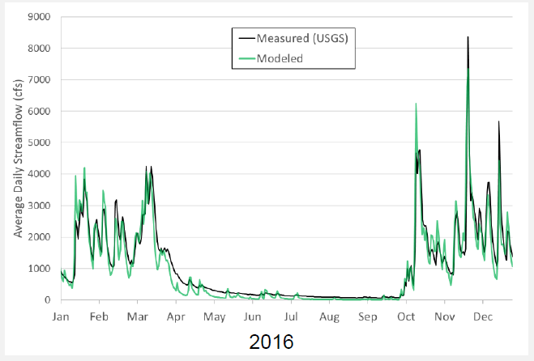
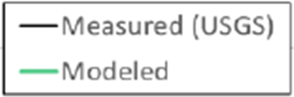
North Fork Tolt River, WA
Mashel River, WA
N. Fork Tolt River
Mashel River
Tillamook Bay
Trask River, OR (Tillamook Bay trib)
HJ Andrews LTER
(Calibration Site)
13

Slide 14
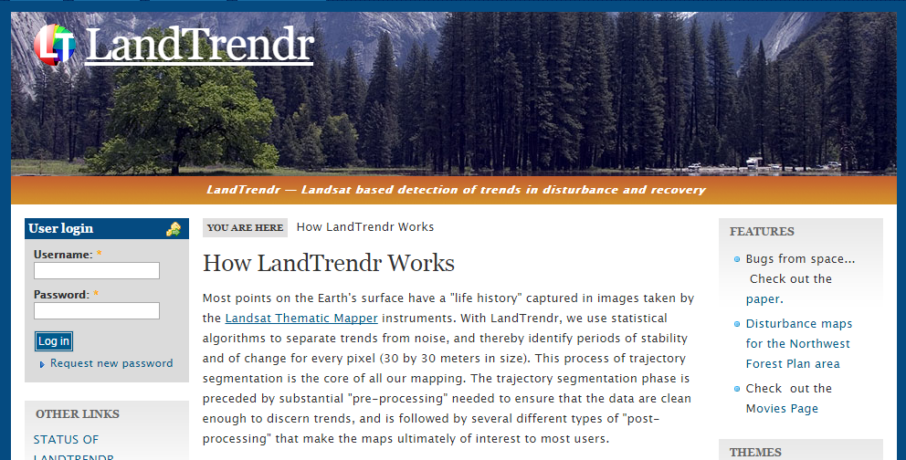
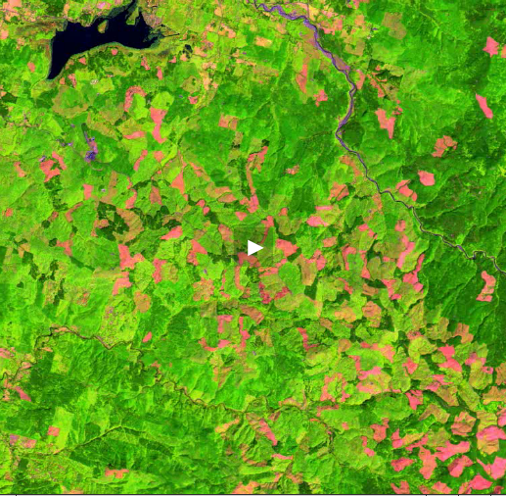
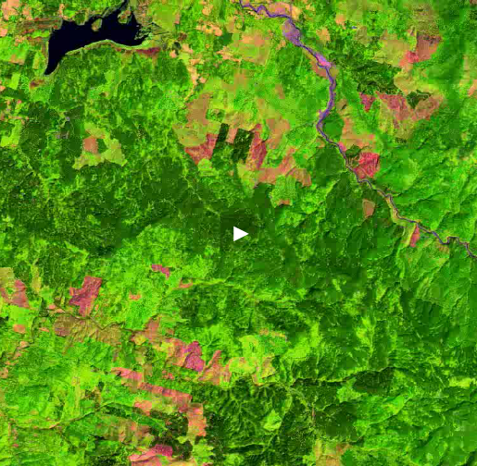
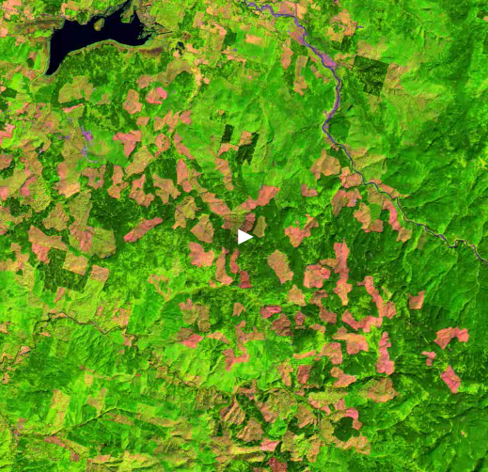
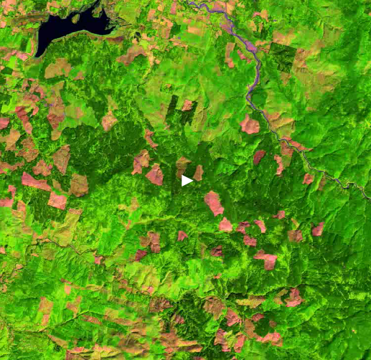
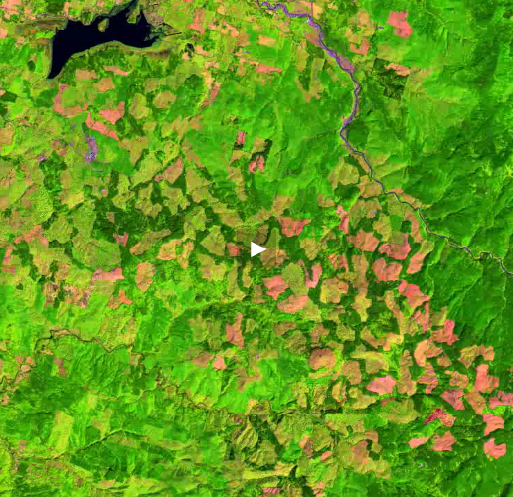
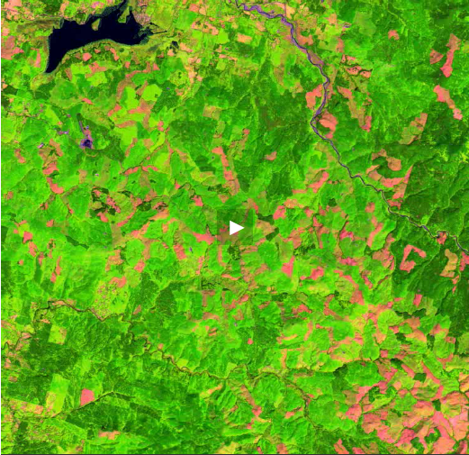
Remote Sensing of Land Use Change
Dr. Robert Kennedy
Oregon State University
1985 – 2010 (movie)
1985
2010
1995
2000
2005
Old Forests
Young Forests
New Clearcuts
1990
NW forest landscapes are much younger than 30 years ago
~400 mi² landscape NE of Kelso, WA
14
114

Slide 15
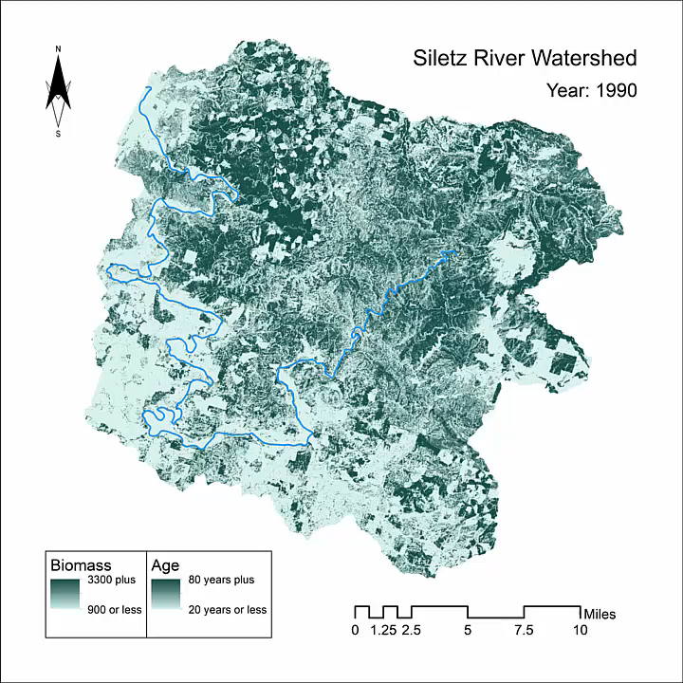
To activate animation, click space bar when in slide show view
Lincoln City, OR
Harvest Animation,
Depot Bay, OR
15

Slide 16
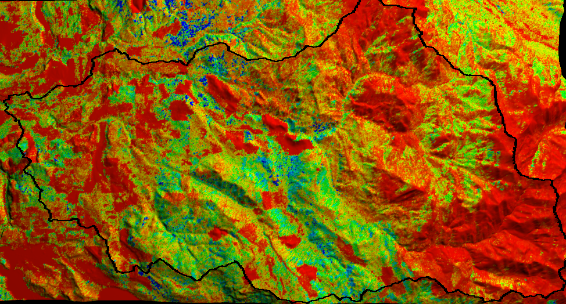
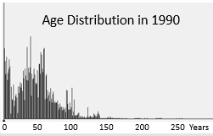
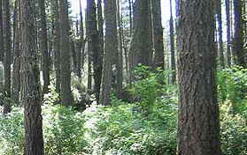

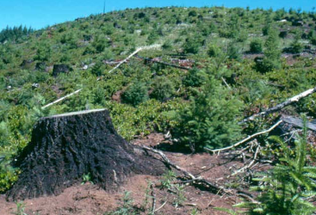
Mashel Forest Biomass in 1990
LandTrendr Data
148 m
Aboveground Biomass, Mg C/ha)
300
225
150
75
<5
1460 m
0 5 10 km
16
Notes:
This image, based on Landsat satellite imagery, further highlights the spatial distribution of forest biomass in the Mashel Basin landscape.
Areas in red/yellow/green are young stands that that have been harvested in recent decades. These young stands clearly dominate the present-day landscape.
The areas shown in blue are remnant old-growth forests.
These old stands are mostly located within the Busy Wild Creek sub-watershed, portions of which are being considered for protection through financial land acquisition arrangements.
As we will see a little later in this talk, the old forests within the Busy Wild play several potentially important roles for the recovery of salmon within the Mashel Basin.

Slide 17
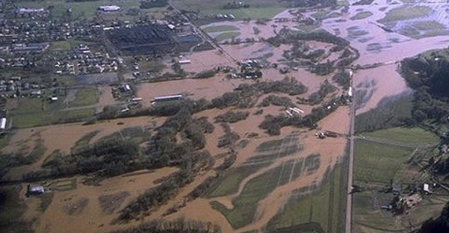
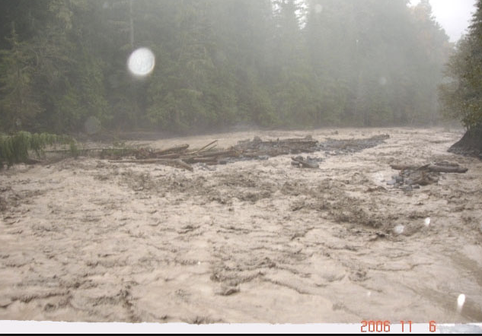
VELMA
Peak and Low Flows
2006 Nov 6
2015 Aug 20
17

Slide 18


Young vigorously growing forests can transpire over three times more water than old forests
Young Forest
Old Forest
Figure 3 from Moore et al. 2004, Tree Physiology 24, 481-491
(Research conducted at HJ Andrews Experimental Forest, OR)
Higher Transpiration
Lower Transpiration
40 year-old stand
Transpiration (mm day⁻¹)
450 year-old stand
Day of Year
18

Slide 19







Watershed 10, HJ Andrews, OR
0.1 km² headwater catchment
450 year-old conifer forest
Clearcut in 1975
Stream discharge data 1969-present
Gauge
Forest age effect turned OFF
Forest age effect turned ON
HJA
HJA
100
10
1.0
0.1
0.01
3-year running means
3-year running means
Streamflow, mm/day
Observed
Modeled
3x more low flow with age effect
1969
1970
1971
1972
1973
1974
1975
1976
1977
1978
1979
1980
1981
450 year-old forest
Clearcut 1975
19

Slide 20



Mashel River Watershed, WA
209 km²
Mixture of forest stand ages, most less than 60 years-old
Stream discharge data, 1992-present
Effect of forest age on summer low flow scales up well from a headwater catchment in Oregon to the 2,000x larger, mixed-age Mashel watershed
(no parameters were changed, only drivers)
Observed
February 5-7, 1996
rain-on-snow event
Observed
Modeled
Streamflow, cfs
Streamflow, mm/day
Observed
Modeled
20

Slide 21

Can longer forest harvest intervals increase summer streamflow for salmon recovery?
Simulated September Minimum Daily Flow
Average for 2006-2014
Yes, VELMA results indicate that establishment of older (>80 yr?) forest landscapes could substantially increase summer low flows compared to the present-day Mashel watershed
11 cfs
6 cfs
2 cfs
Actual
40 yr
100 yr
Mashel Forest Landscape Age
21

Slide 22



starkerforests.com
starkerforests.com
starkerforests.com
Long harvest rotations: up to 80 years, with thinning → maximize timber value
1936: 110 acres of Coast Range second-growth
Now: 86,000 acres of standing timber (growth exceeds harvest)
Sustainably harvesting 15 million to 20 million board-feet per year
About $15 million in annual sales
Fish passage (culverts) & habitat improvement
Water quality protection (skyline logging, road maintenance)
22

Slide 23

VELMA
Large Woody Debris
23

Slide 24


Riparian Large Woody Debris
Mashel Basin – VELMA Simulation, Year 2000
148 m
Riparian Woody Debris Mg C/ha
90
84
77
70
64
58
51
45
38
1
<0.5
1460 m
VISTAS 3D visualization of VELMA output
USEPA Office of Research and Development
National Health and Environmental Effects Research Laboratory
0 2 4 6 8 10 km
24

Slide 25

Penumbra
Stream Shade & Temperature
http://il8.picdn.net/shutterstock
25

Slide 26





Penumbra: Stream Shade & Temperature Model
Developer: Jonathan Halama
Stream shade component (done)
Integrate with VELMA for dynamic vegetation (done)
Stream temperature (draft)
Calapooia River, OR
Stream shade time lapse, June 15
26
Notes:
The stream shade animation (lower right) is a time lapse display of riparian shade at 15-minute intervals from sunrise to sunset om June 15.
The stream shade model, Penumbra, generates daily aggregate shade/irradiance for each pixel within the landscape of interest, factoring in effects of tree height (LIDAR or modeled data) and topography (DEM data).
Modeled irradiance data are then used to calculate heat load → stream temperature, using methods similar to the Heat Source model developed by the Oregon Department of Environmental Quality.
Penumbra is designed to have fewer data requirements and be simpler to apply than Heat Source. Penumbra has been linked to VELMA to enable dynamic simulation of future changes in stream shading and temperature in response to changes in riparian forest height and climate change.
The Penumbra shade model was developed by Jonathan Halama as part of his PhD dissertation at Oregon State University. Jonathan is currently a postdoc with the VELMA team. Contact: halama.jonathan@epa.gov.

Slide 27

Climate Refuges
Where and what type of restoration practices can help establish cold water refuges for salmon?
Blue = cold water
Riparian Shade
Snowpack
Groundwater
Hyporheic flow
Large wood
Aimee Fullerton, NOAA/UW
Joe Ebersole, EPA
27

Slide 28

EDT
Fish Habitat
28

Slide 29


Fish Habitat Modeling: Ecosystem Diagnosis & Treatment (EDT) Model
EDT is a fish life-cycle habitat model
Synthesize available information
Identify limiting habitat factors
Prioritize habitat restoration needs
Help managers design restoration solutions to meet recovery targets
Greg Blair, ICF International
29

Slide 30





Modeled effects of summer low flows on Mashel adult salmonid abundance
% Decrease in Fish Abundance: Young Forest Fish Abundance – Old Forest Fish Abundance
0
-20
-40
-60
% Decrease in Fish Abundance
These results do not yet include harvest effects on stream temperature, large woody debris, or sediments
Greg Blair, ICF International
30

Slide 31


Nisqually Community forest
Prevailing
Forest Mgmt
Long rotations with thinning
Young forests,
Short rotations
Old Forests
Lower ET
Higher low flow
Lower peak flow
Lower temps
Less sediment
More large wood detritus for spawning and rearing habitat, prey species
Higher ET
Lower low flow
Higher peak flow
Higher temps
More sediment
Less large wood detritus for spawning and rearing habitat, prey species
31

Slide 32
Salmon recovery model scenarios
Identify salmon habitat restoration priorities:
Streamflow, LWD, temperature, sediments?
How much restoration & where?
How long for restoration to have an impact?
Can restoration help mitigate effects of climate extremes & long-term trends?
Scenarios for balancing diverse objectives: salmon, timber, drinking water quality & quantity, carbon sequestration, local forest sector jobs…
32

Slide 33


Key goal: tool transfer to communities, tribes, states
Key goal: Tool transfer to stakeholders
Workshops
Online training & downloads
https://www.epa.gov/water-research/visualizing-ecosystem-land-management-assessments-velma-model-20
33

Slide 34

Thanks!
mckane.bob@epa.gov
Associated Press

